Slide 1
LARES INTERNATIONAL
EP ROLL / FLOOR PROTECTION SHEET
DUCT TAPE
STUCCO PLASTIC PROTECTION – HIGH END
BOPP BASED PROTECTION – LOW END
MASKING TAPE
STRETCH FILM
BARRICADE TAPE
SLAB JOINT BACKING TAPE

Slide 2
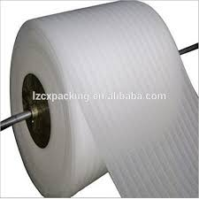
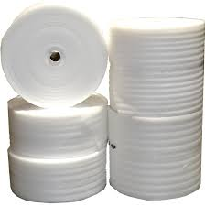
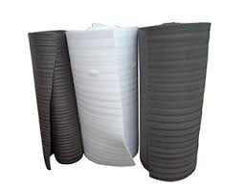
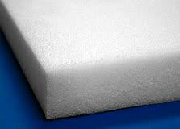
EP SHEET - ROLL
Low cost can be reusable & also heat seal.
Covers wide range of use in construction sites
Used on floor.

Slide 3
DUCT TAPE
Used in sizes of 96mm for strong bonding between sheet
Durable under harsh conditions

Slide 4
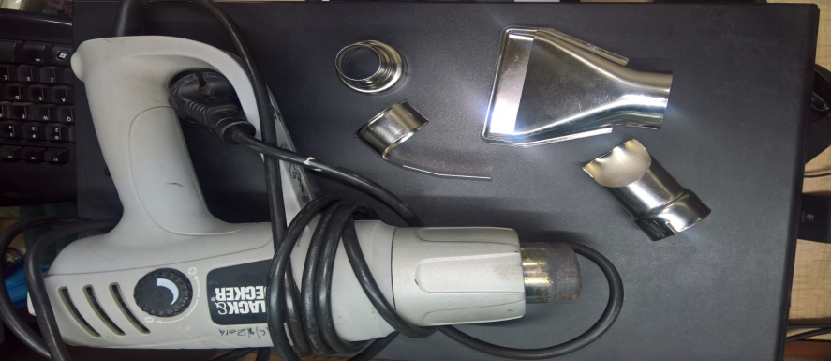
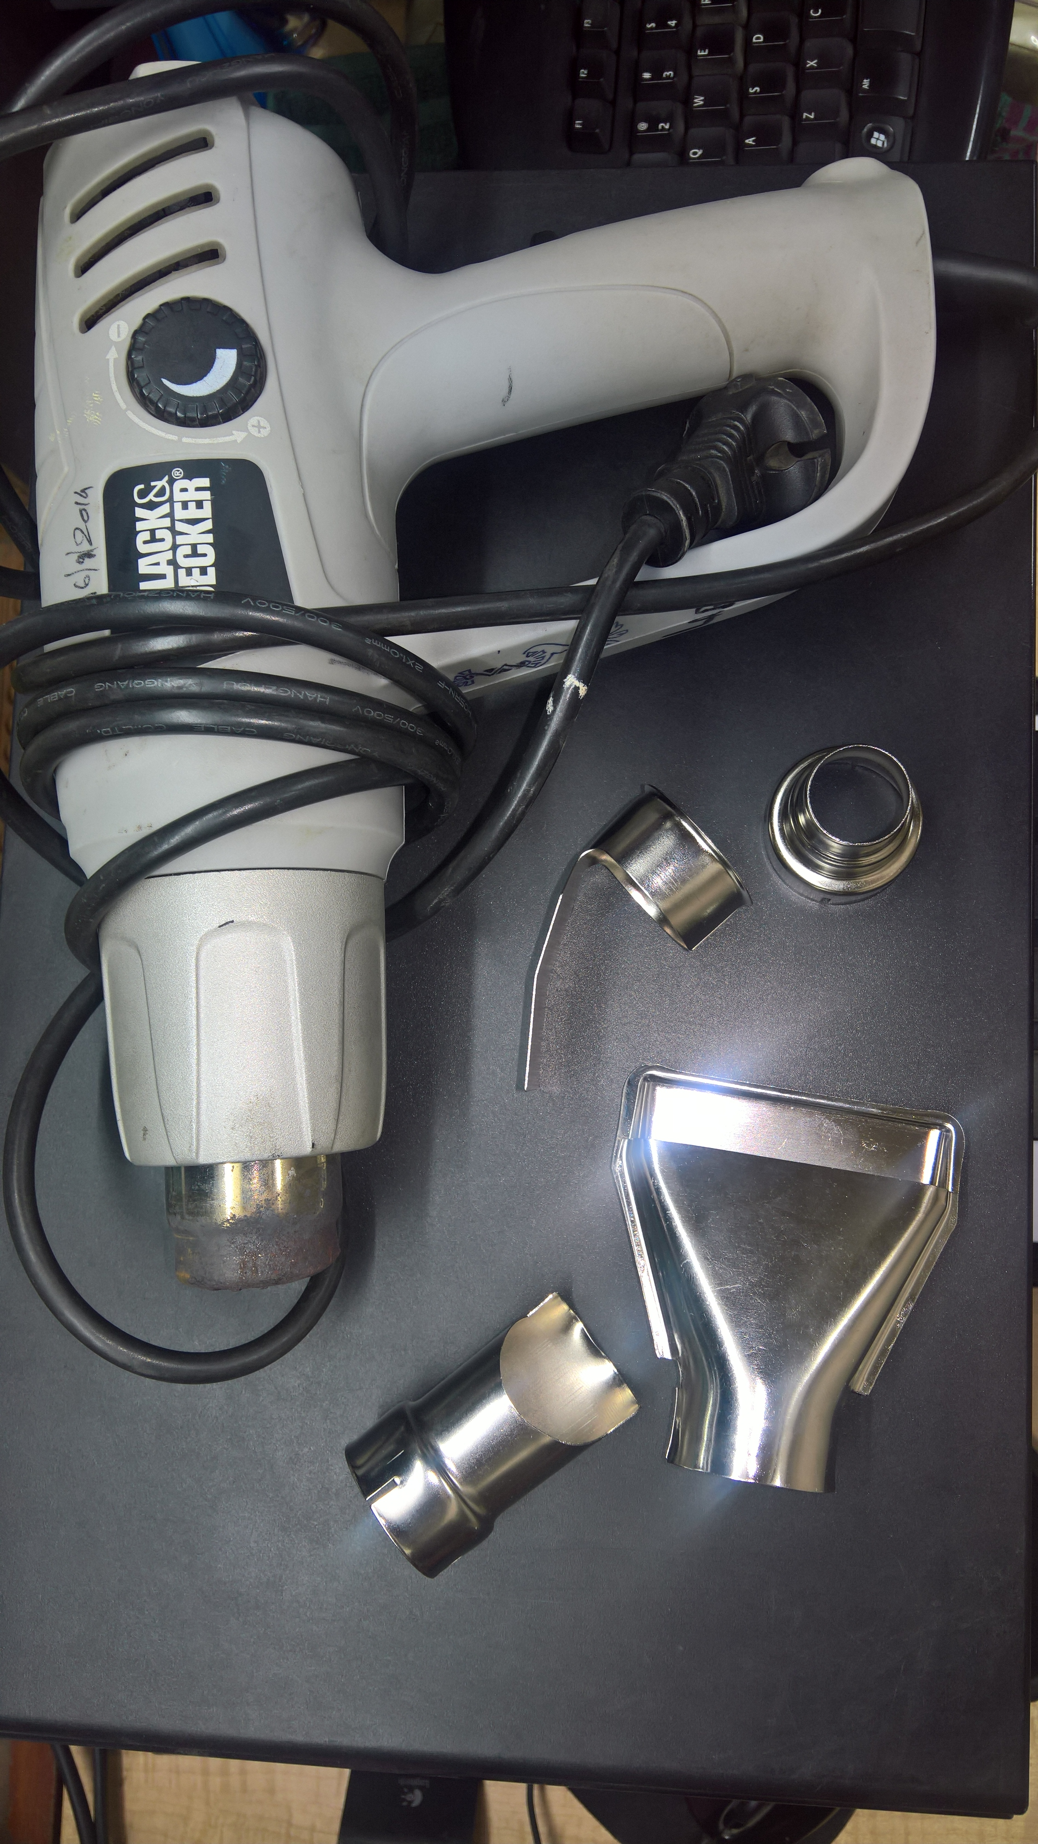
FLOOR PROTECTION FIXING HOT AIR GUN
Easy to handle. Minimizing Material & labour cost.
Requires less Energy. Time saving. Long durability.
Suitable to any weather condition.Generates Excellent bonding. Excellent Productivity & protection.

Slide 5
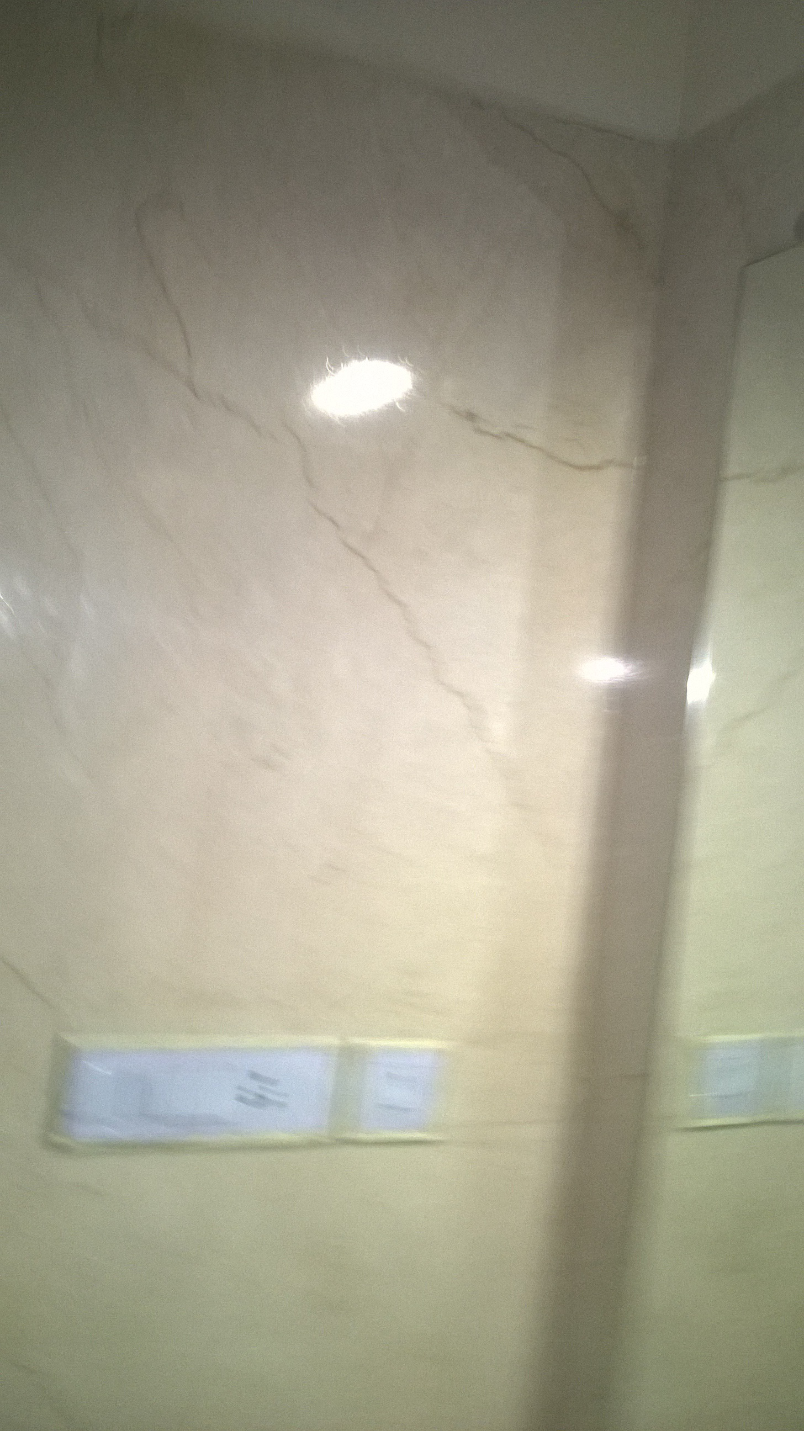
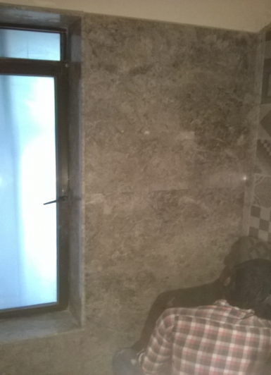
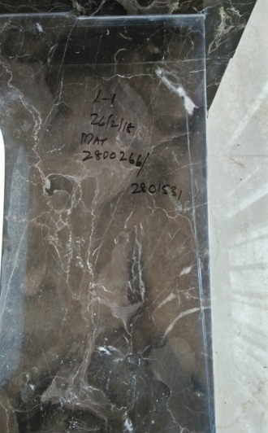
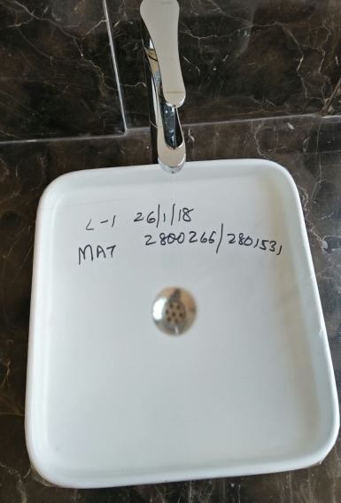
STUCCO PLASTIC
SIZE OF 480MM USED ON SURFACE LIKE DADO WALLS CLADDING IN COMMON AREA , BATHROOM GLASS FITOUTS PARTION
A HIGH END PRODUCT USED IN PLACE WHERE LOW END PROTECTION DOES NOT WORK DUE TO TILE QUALITY .

Slide 6
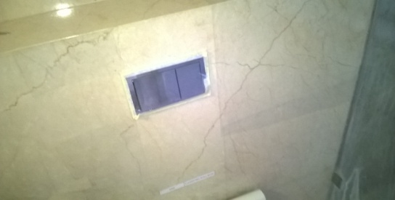
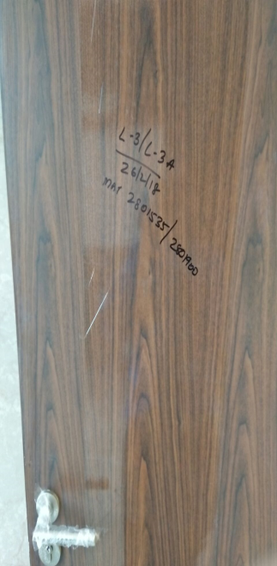
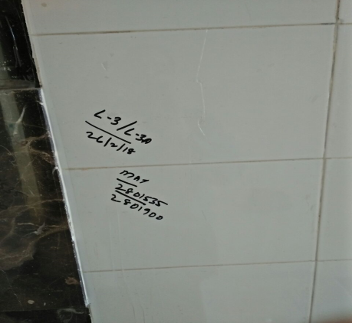
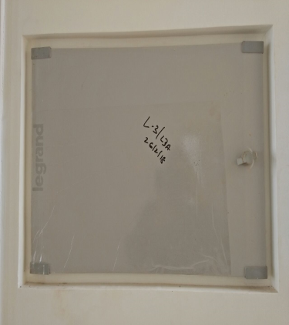
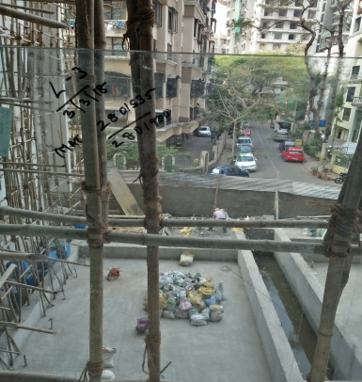
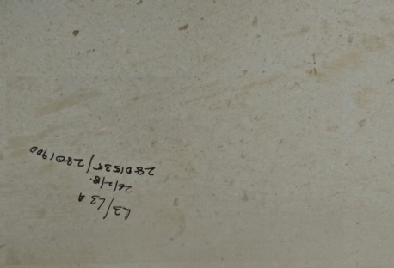
BOPP PROTECTION FILM
Multi use protection cost saving ranging doors, floors ,tiles, floor,panels balcony terrace glass

Slide 7
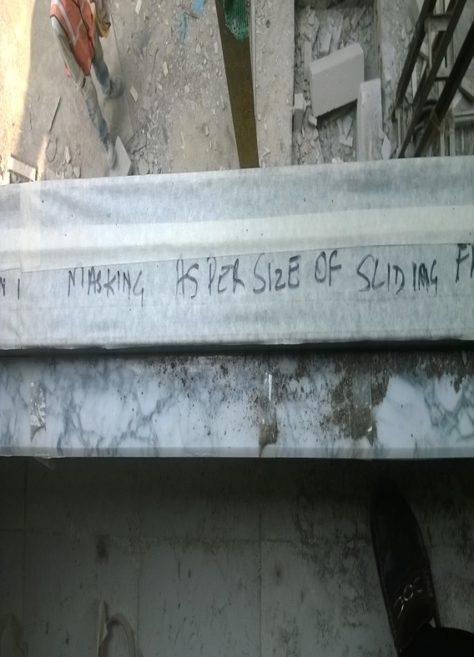
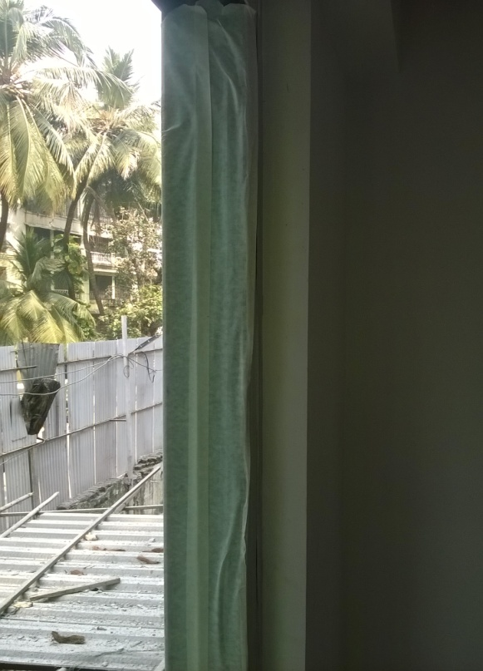
MASKING
Used primarily before painting application

Slide 8
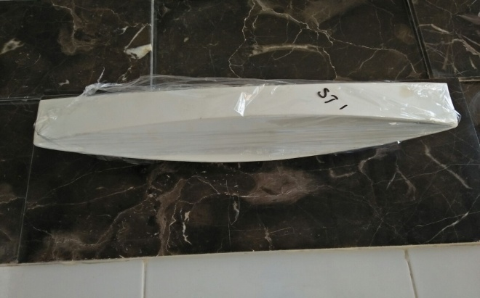
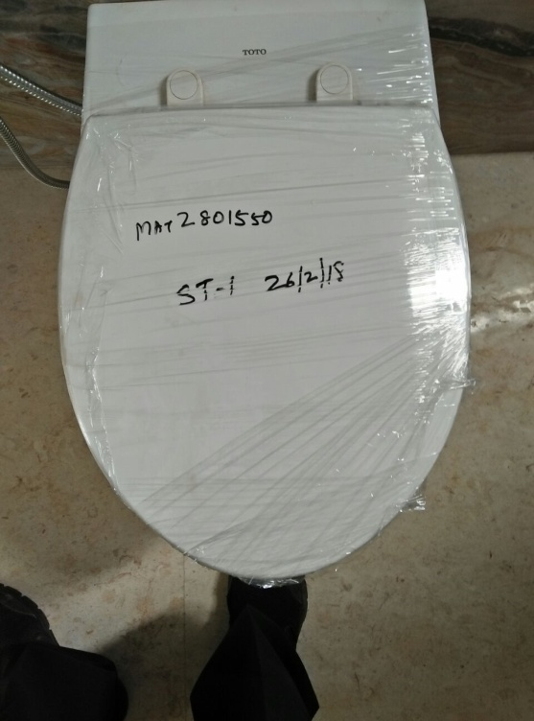
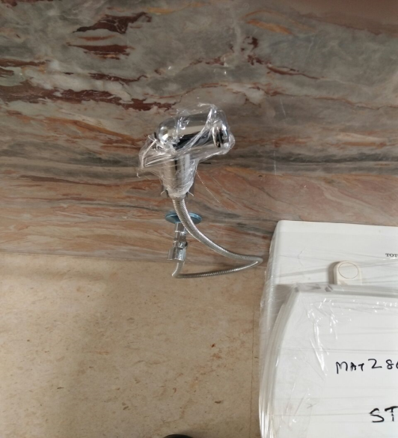
STRETCH
Used for covering of fitting and Sanitaryware

Slide 9
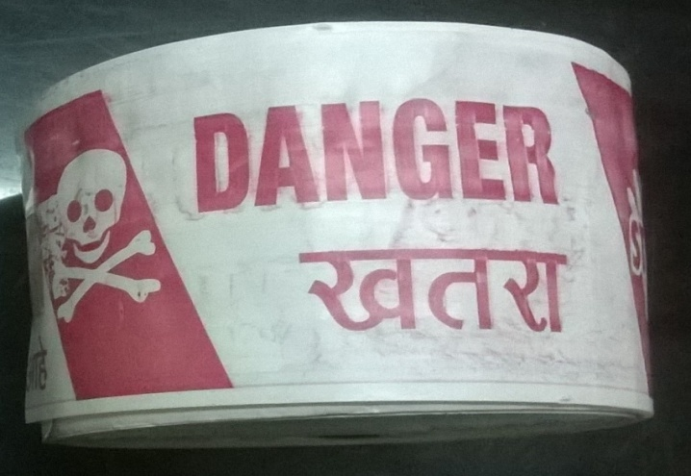
BARRICADE TAPE
Used at construction sites.

Slide 10
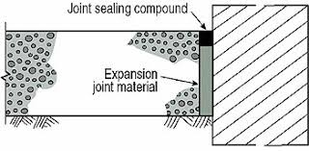
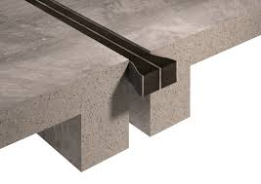
SLAB JOINTS BACKING
SIZES IN MM : 1,2,3,4,5,6,8,12
One sided adhesive coated with release linear Silicon base or Clear PET
Available in rolls of 5 mtrs and 10mtrs.
Used in joints covering.

Slide 11
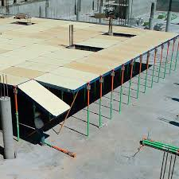
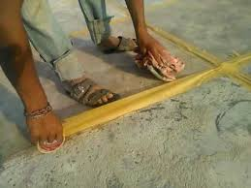
SLAB TAPE
SIZES OF 72MM , 96MM 120MM
USEFUL IN SHUTTERING AVOID SPILLAGE OF CONCRETE READY MIX
COST SAVER BY SAVING EXCESS MIX FROM FORMING BETWEEN JOINTS AND REDUCE LABOUR COST .

